Slide 1
LLM analysis
Introduction, Principle & Models in market
Pengyao Zhao

Slide 2
Introduction
Deep Learning Model
Language Model
Large Language Model (LLM)

Slide 3
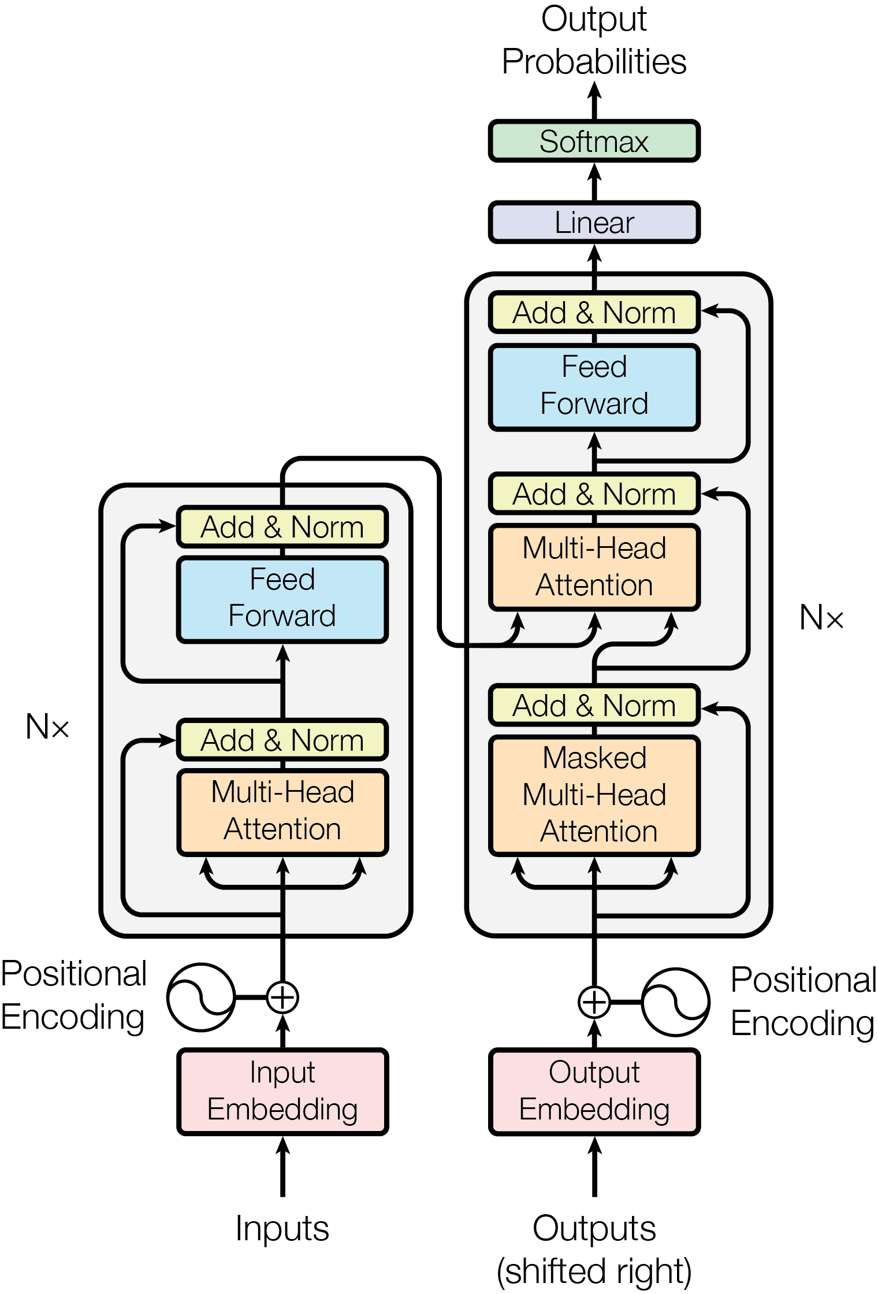
Deep Learning Model
A deep learning model is based on artificial neural networks with multiple layers between the input and output layers.
These models are capable of learning hierarchical representations of data through the process of training on large amounts of labeled data.

Slide 4
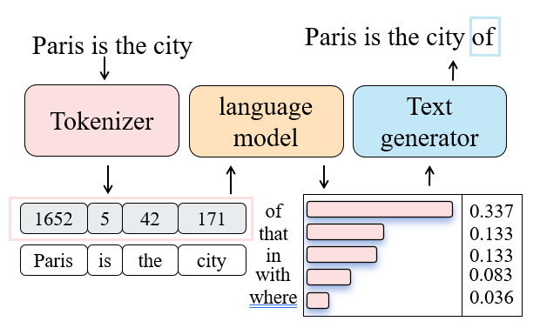
Language Model
A modern language model is a deep learning model that is trained to predict the probability of output words. There are three key components of the language model pipeline as following.
Architecture: Transformer architecture, which is used in nearly every modern LLM.
Tokenizer: Convert text data into a token format that the model can understand.
Text generator: Generate output sequences from probability of words. Common strategies include greedy decoding, beam search.

Slide 5
Large Language Model
large language model (LLM) : A language model that achieves the emergent abilities that are not present in small models but arise when the scale reaches a certain level.
The emergent abilities specifically refer to in-context learning (understand prompt), instruction following, and step-by-step reasoning (involve intermediate reasoning steps).
The scale specifically refers to the parameter count and the amount of text training data. An example in Table 1 shows the scale difference between LLM and small language model (SLM).
Table1 Scale difference between LLM and SLM
model | parameter count | amount of training data
BERT | 340M | 3300M words
Llama3 (large model) | 70B | 15T tokens
Note: 1 token ~= ¾ words

Slide 6
LLM’s Principles
Supervised Pre-training
Supervised Fine-Tuning (SFT)
Preference Alignment (optional)

Slide 7
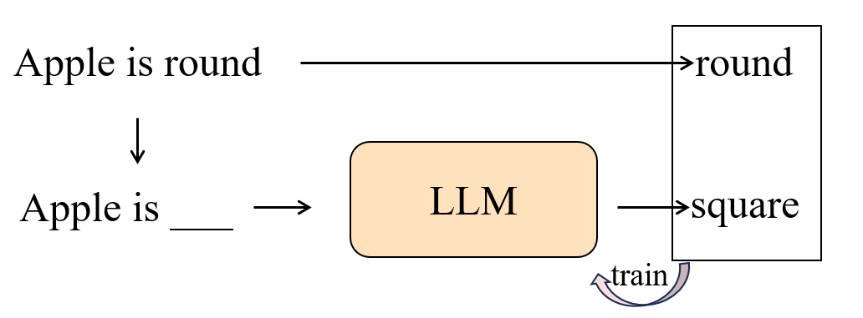
Supervised pretrain
Supervised pre-training is a very long and costly process, where models are only trained on a next-token prediction task.

Slide 8
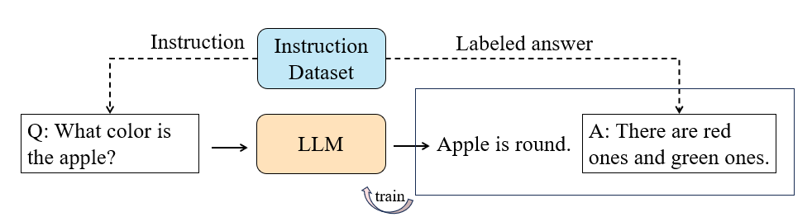
Supervised Fine-Tuning (SFT)
Only a pre-trained model is not helpful assistants, but Supervised Fine-Tuning (SFT) can enhance its ability to respond to instructions.
SFT achieves this by using datasets that contain instruction-answer pairs for training.

Slide 9
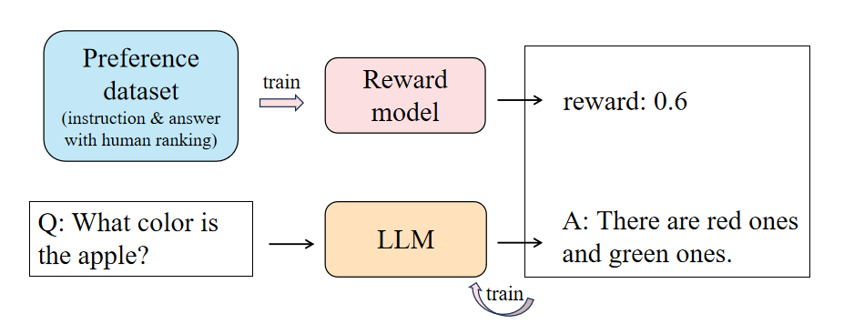
Preference alignment (optional)
Preference alignment is a next step used to align the LLM's answers with human expectations. It is more complex than SFT and often seen as optional. Common strategy is RLHF.
RLHF (Reinforcement Learning from Human Feedback) leverages a reward model and reinforcement learning to optimize the SFT model, ensuring that its output answers closely match those rated highly by humans.

Slide 10
Models in market
overview of popular LLM
Performance and Capability
Price for chat

Slide 11
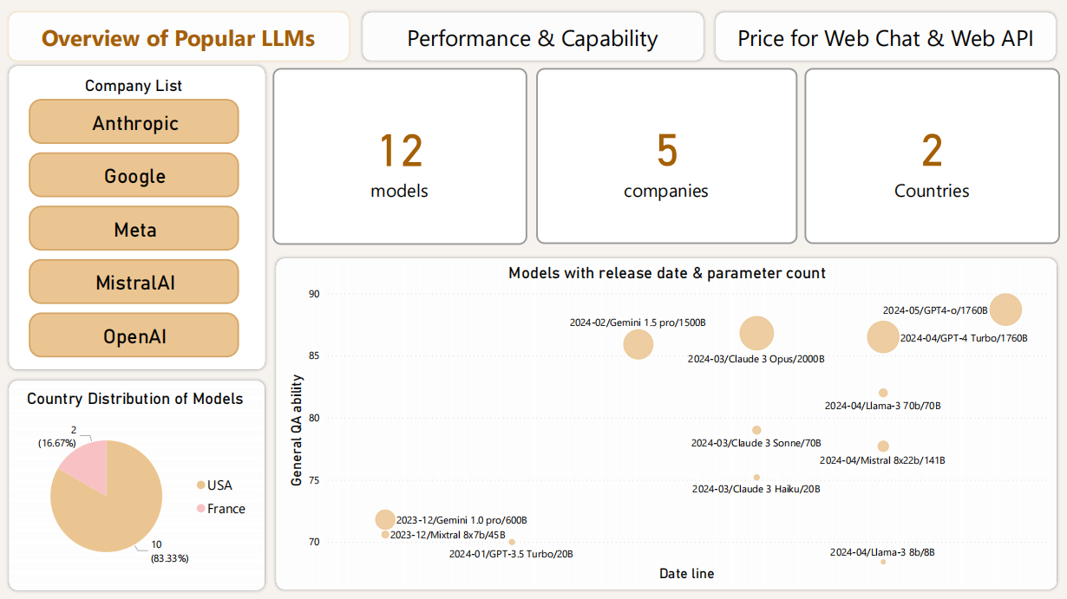
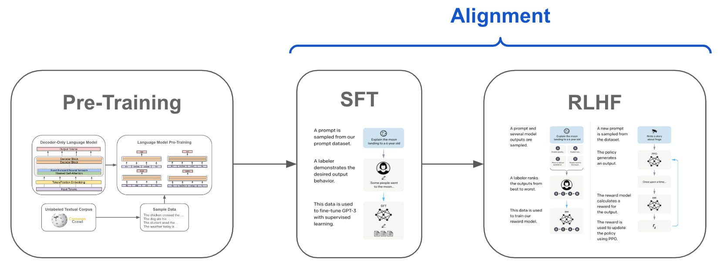

Slide 12
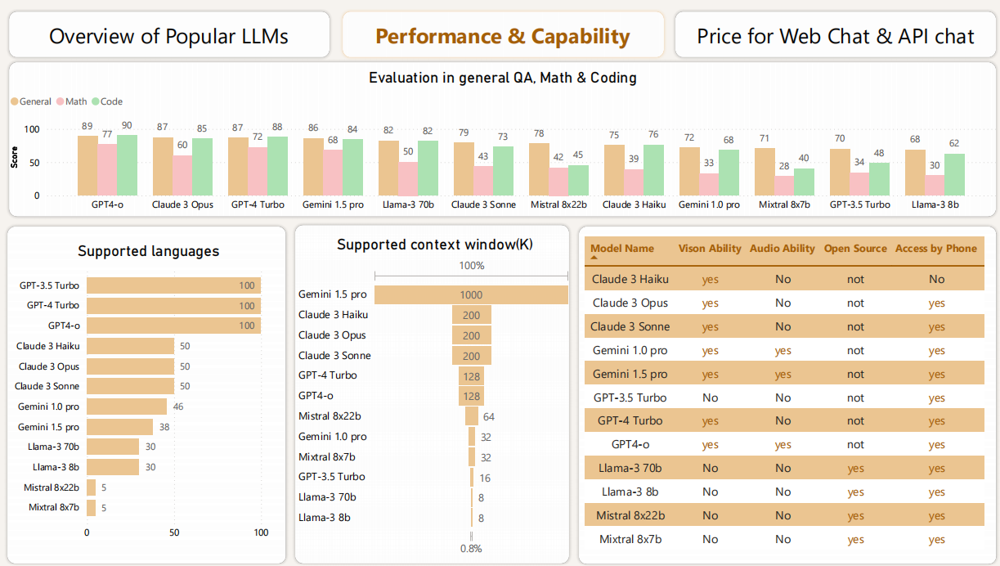

Slide 13
